Slide 1
Flexible Mappings Items

Slide 2
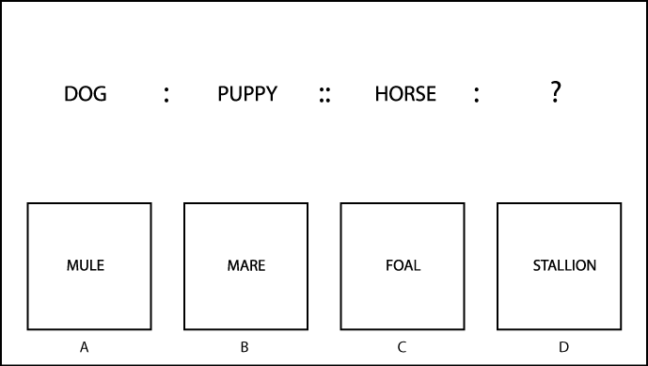
DOG
PUPPY
HORSE
MULE
MARE
FOAL
STALLION

Slide 3
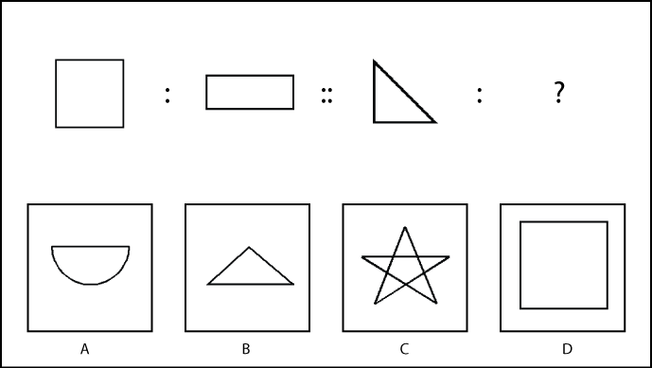

Slide 4
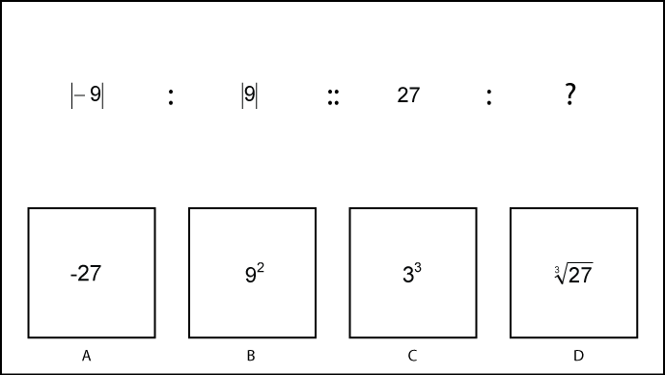
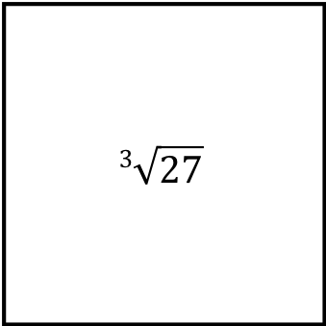
|-9|
|9|
27
-27
9²
3³
$$\sqrt[\text{3 }]{\text{27}}$$

Slide 5
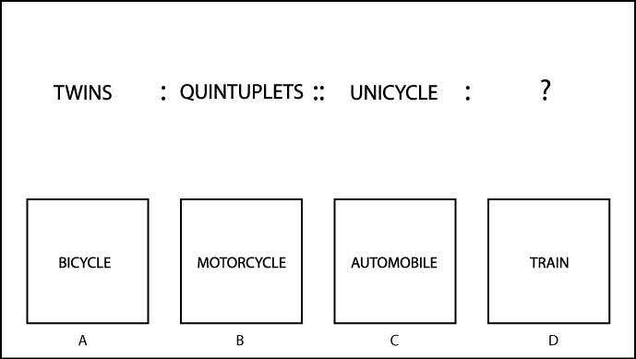
TWINS
QUINTUPLETS
UNICYCLE
BICYCLE
MOTORCYCLE
AUTOMOBILE
TRAIN

Slide 6
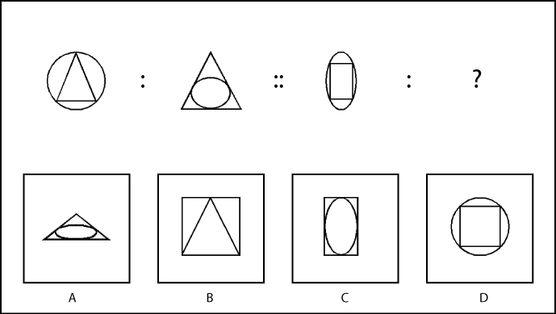

Slide 7
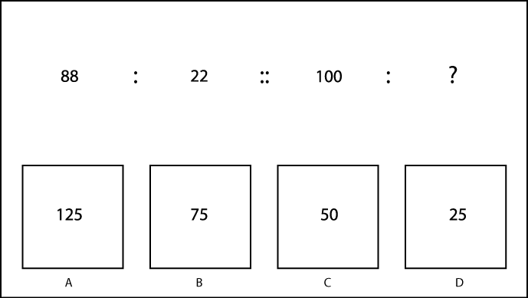
88
22
100
125
75
50
25

Slide 8
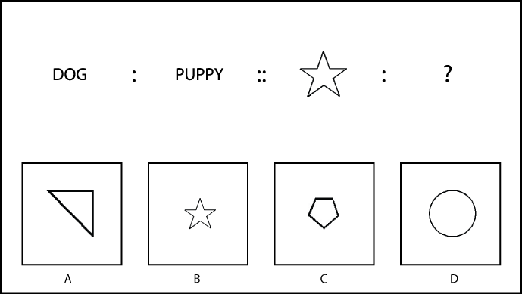
DOG
PUPPY

Slide 9
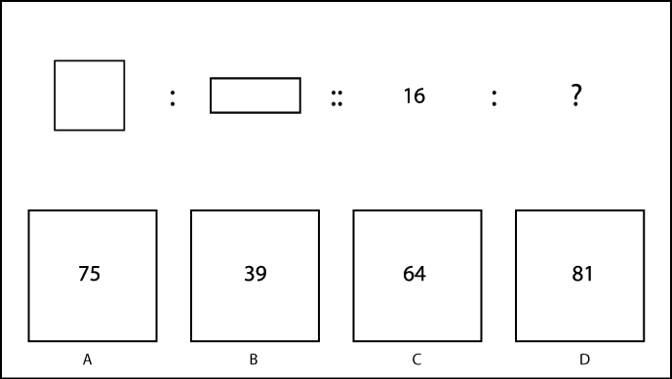
16
75
39
64
81

Slide 10
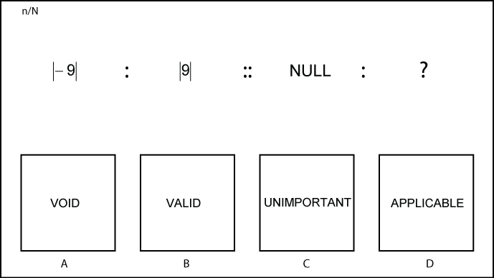
|-9|
|9|
NULL
VOID
VALID
UNIMPORTANT
APPLICABLE

Slide 11
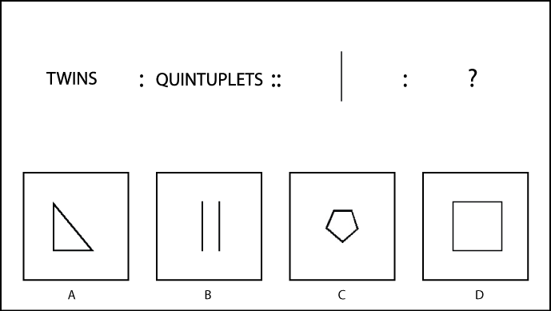
TWINS
QUINTUPLETS

Slide 12
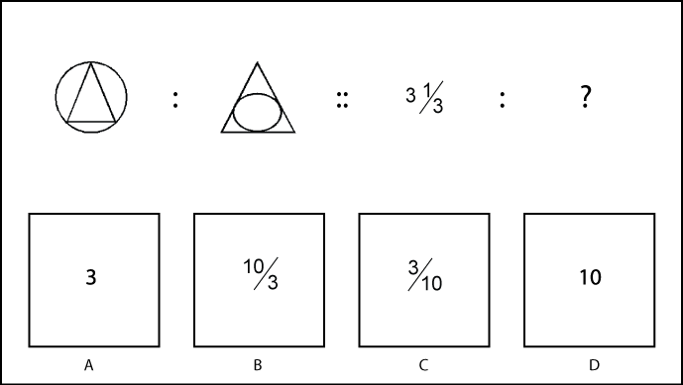
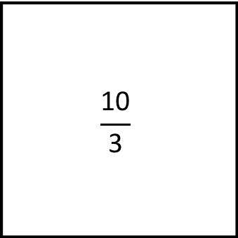

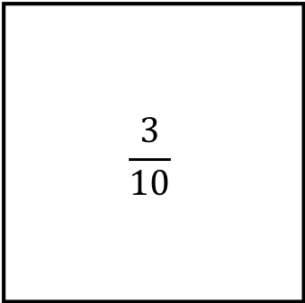
3$\frac{\text{1}}{\text{3}}$
3
$$\frac{\text{1}\text{0}}{\text{3}}$$
$$\frac{\text{3}}{\text{10}}$$
10

Slide 13
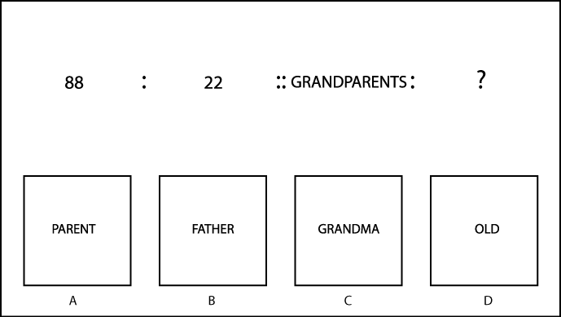
88
22
GRANDPARENTS
PARENT
FATHER
GRANDMA
OLD

Slide 14
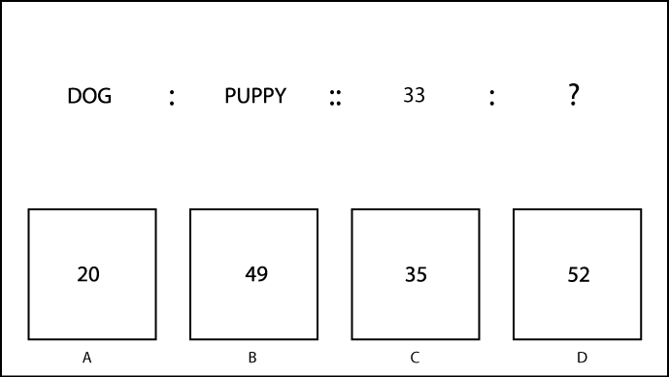
DOG
PUPPY
33
20
49
35
52

Slide 15
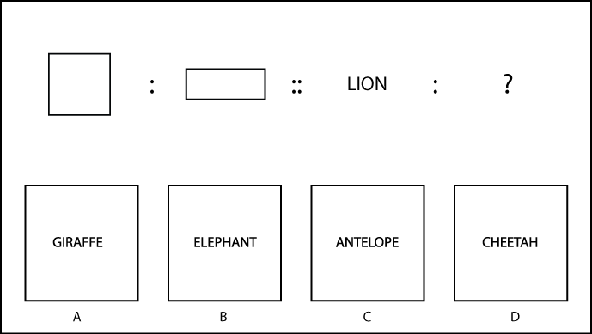
LION
GIRAFFE
ELEPHANT
ANTELOPE
CHEETAH

Slide 16
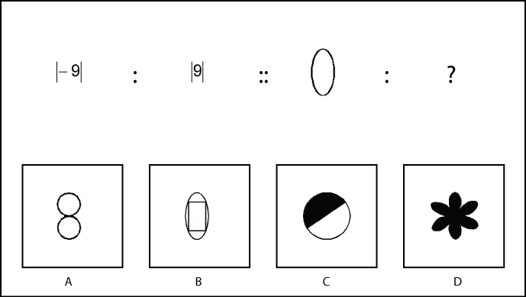
|-9|
|9|

Slide 17
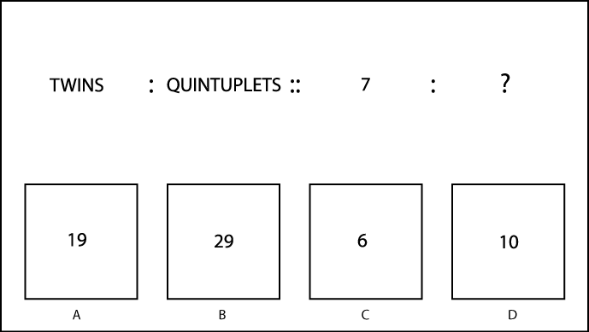
TWINS
QUINTUPLETS
7
19
29
6
10

Slide 18
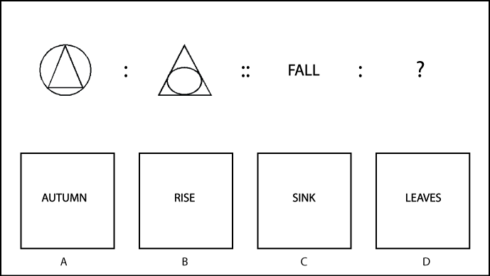
FALL
AUTUMN
RISE
SINK
LEAVES

Slide 19
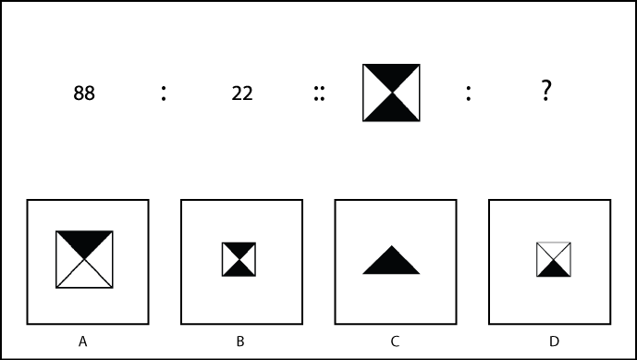
88
22

Slide 20
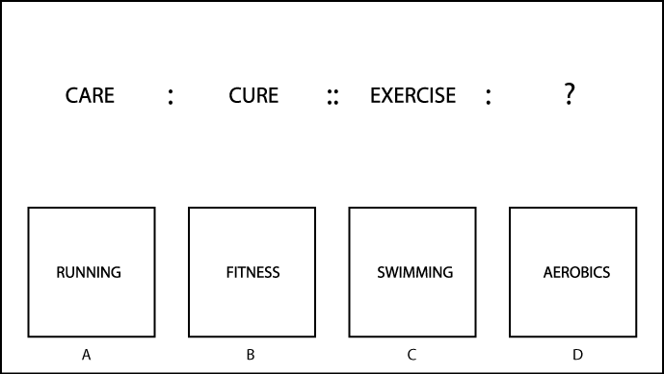
CARE
CURE
EXERCISE
RUNNING
FITNESS
SWIMMING
AEROBICS

Slide 21
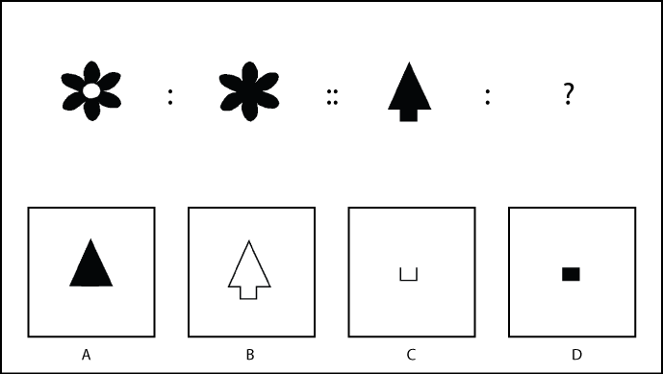

Slide 22
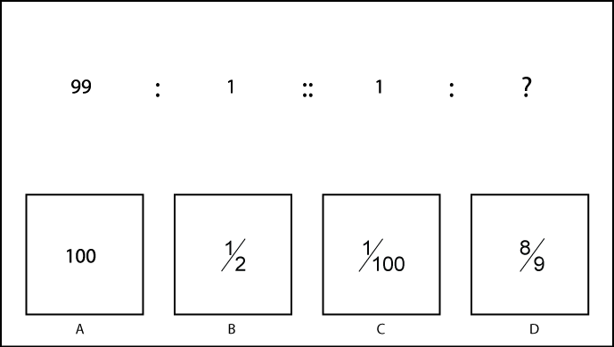
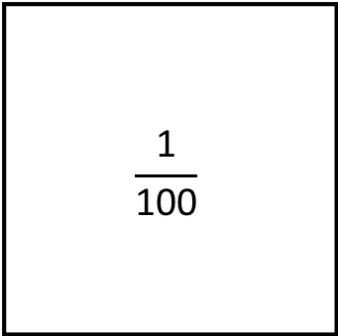
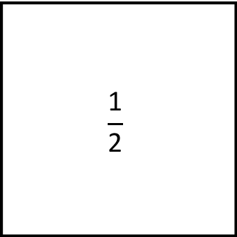
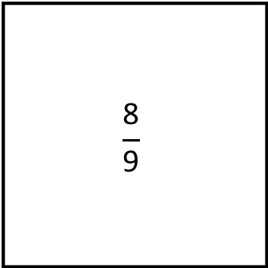
99
1
1
100
$$\frac{\text{1}}{\text{2}}$$
$$\frac{\text{1}}{\text{100}}$$
$$\frac{\text{8}}{\text{9}}$$

Slide 23
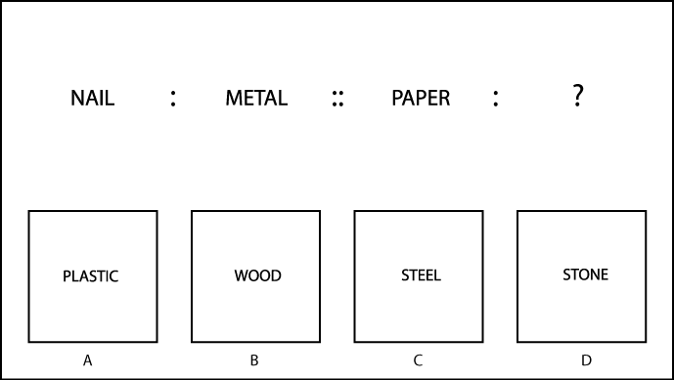
NAIL
METAL
PAPER
PLASTIC
WOOD
STEEL
STONE

Slide 24
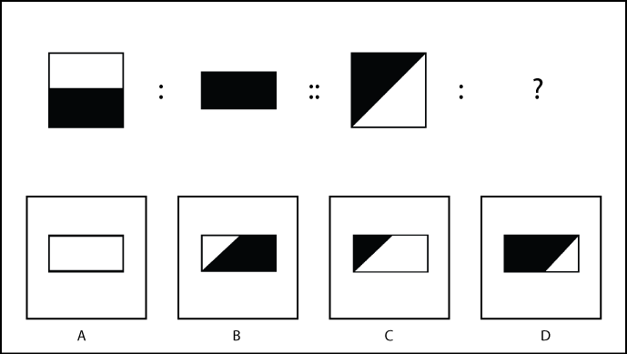

Slide 25
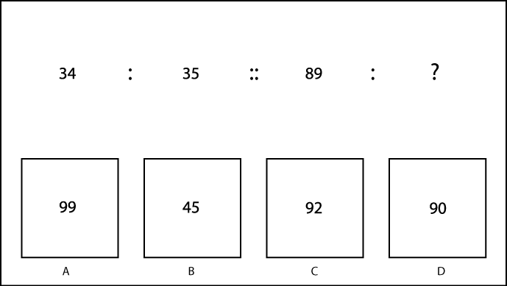
34
35
89
99
45
92
90

Slide 26
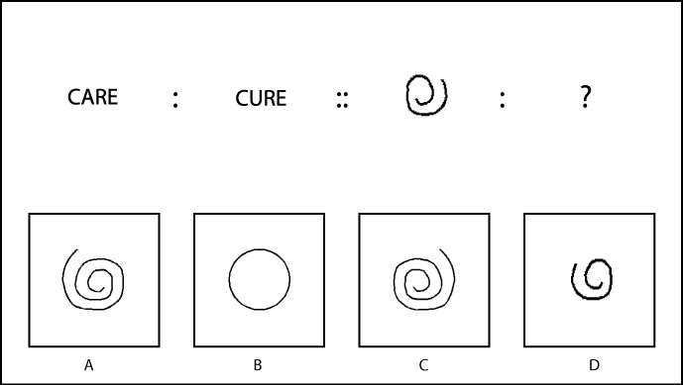
CARE
CURE

Slide 27
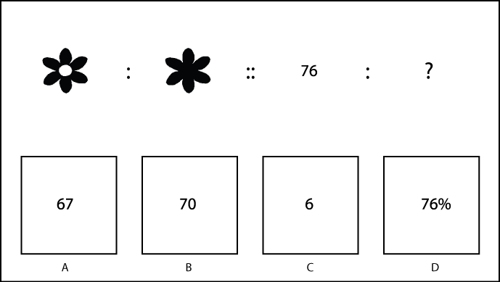
76
67
70
6
76%

Slide 28
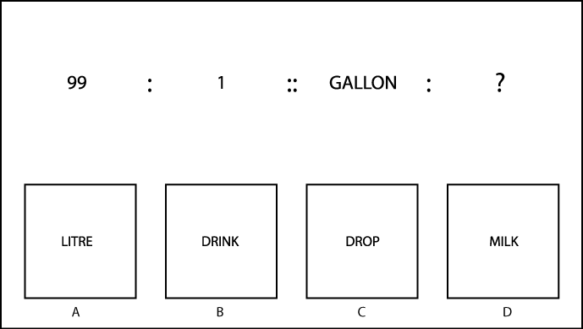
99
1
GALLON
LITRE
DRINK
DROP
MILK

Slide 29
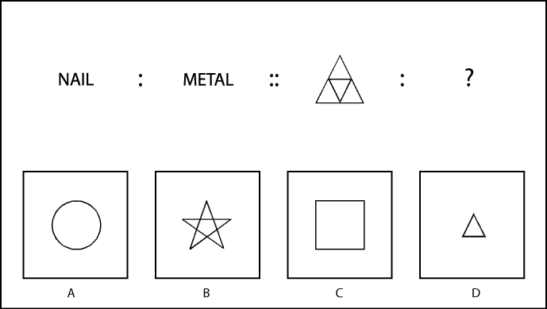
NAIL
METAL

Slide 30
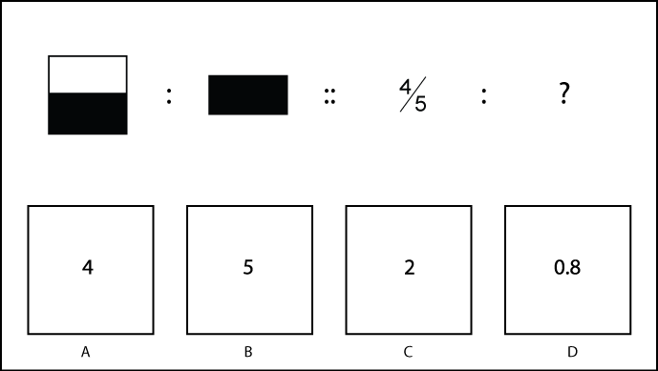

$$\frac{\text{4}}{\text{5}}$$
4
5
2
0.8

Slide 31
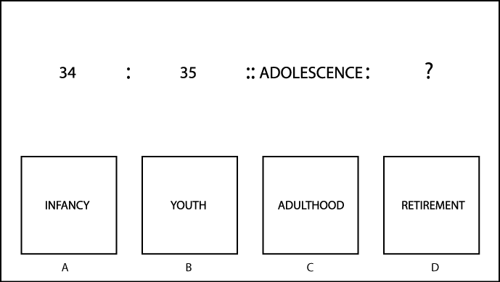
34
35
ADOLESCENCE
INFANCY
YOUTH
ADULTHOOD
RETIREMENT

Slide 32
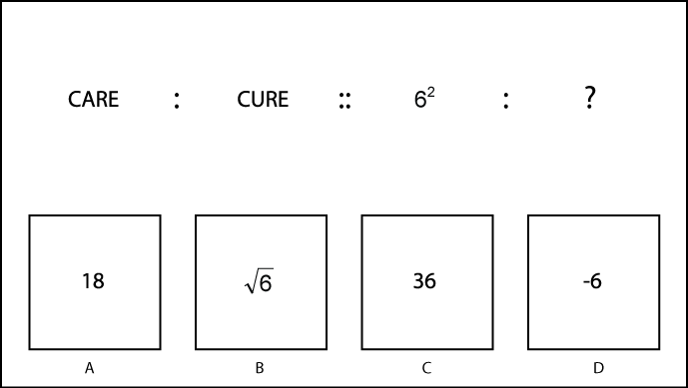
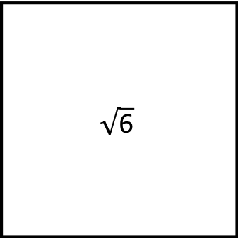
CARE
CURE
6²
18
$$\sqrt{\text{6}}$$
36
-6

Slide 33
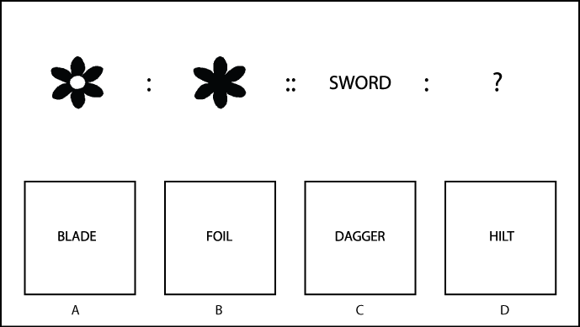
SWORD
BLADE
FOIL
DAGGER
HILT

Slide 34
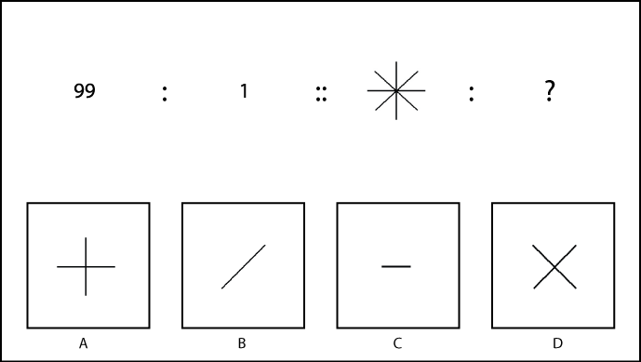
99
1

Slide 35
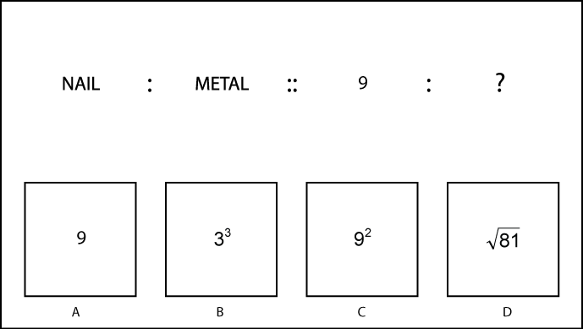
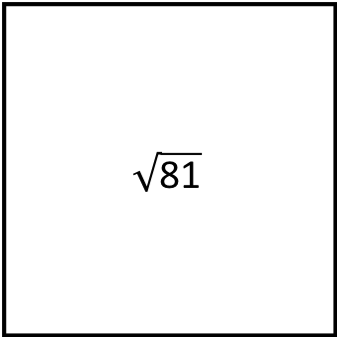
NAIL
METAL
9
9
3³
9²
$$\sqrt{\text{81}}$$

Slide 36

BODY
HEAD
TORSO
LEGS
ARMS

Slide 37
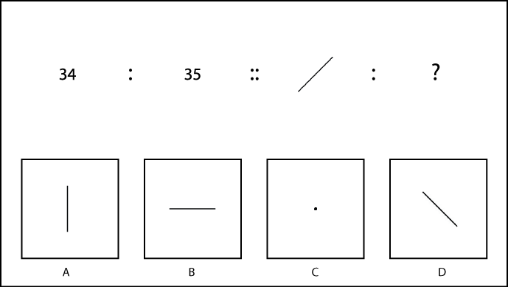
34
35
.

